Slide 1


DSxHealth application
Blai Ras & Lasha Gochiashvili

Slide 2
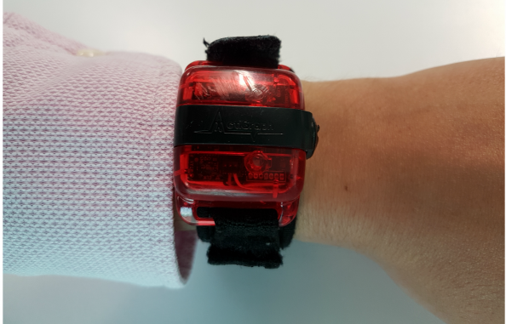
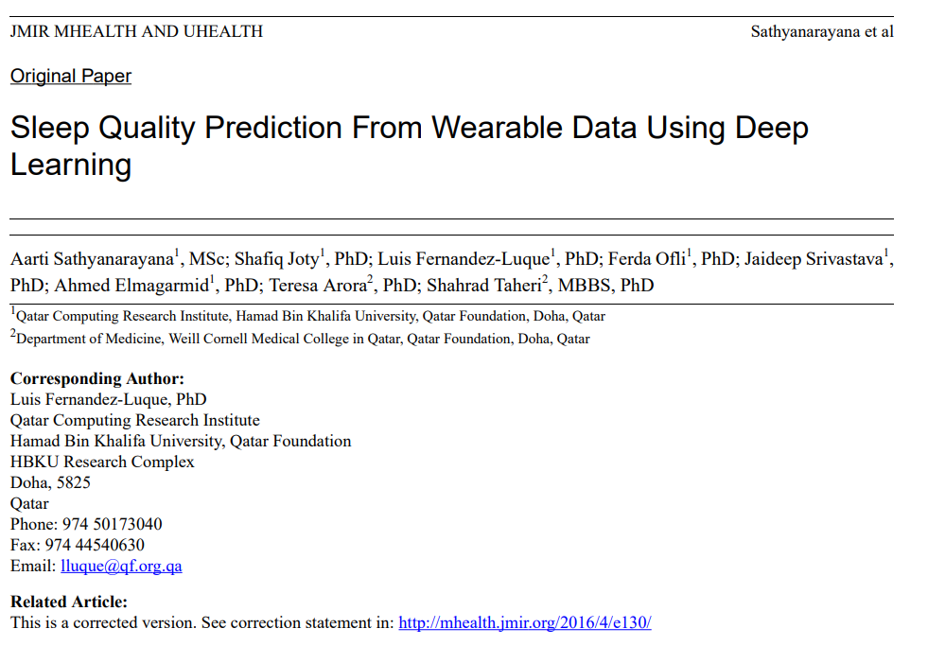

Topic: Wearable Devices for Prevention

Slide 3
Content
Introduction
Background of the problem
Role of Wearables in Sleep Health and eHealth
Objective
Methods
Overview
Data Collection
Data Processing and Representation
Models
Performance Evaluation
Results
Comparison between DL and LR models
Comparison between DL models
Conclusions
Discussion
Findings
Impact in Sleep Science and in eHealth

Slide 4
Importance of the Sleep and connection to Physical activity
Insufficient sleep can reduce physical, emotional, and mental well-being and can lead to a multitude of health complications
Physical activity and sleep are highly interrelated health behaviors.
Our physical activity during the day (ie, awake time) influences our quality of sleep, and vice versa
The current popularity of wearables for tracking physical activity and sleep, including actigraphy devices, can foster the development of new advanced data analytics.
This can help to develop new electronic health (eHealth) applications and provide more insights into sleep science.
Notes:
The importance of sleep is paramount to health. Insufficient sleep can reduce physical, emotional, and mental well-being and can lead to a multitude of health complications among people with chronic conditions. Physical activity and sleep are highly interrelated health behaviors. Our physical activity during the day (ie, awake time) influences our quality of sleep, and vice versa. The current popularity of wearables for tracking physical activity and sleep, including actigraphy devices, can foster the development of new advanced data analytics. This can help to develop new electronic health (eHealth) applications and provide more insights into sleep science.

Slide 5
Role of Wearables in Sleep Health and eHealth
Sleep researchers in the early 1990s developed a technique called actigraphy to study sleep interactions using wearable devices.
There are hundreds of consumer-grade physical activity and sleep tracking devices (e.g. Fitbit) collecting motion
There are successful examples of the integration of physical activity wearable data into eHealth tailored applications (e.g. Smart Watch)
Sensors monitor and observe a patient overnight and can be used for diagnosing different sleep disorders
Notes:
Although actigraphy traditionally uses wearable devices to evaluate the sleep period of a patient, it can also be used to observe physical activity
, including smart-watch health applications that can collect physical activity and sleep data directly from the watch.

Slide 6
Objectives of the study
To test the feasibility of predicting poor or good sleep efficiency based on physical activity data from the awake periods from a wearable device (i.e. actigraphy)
Two-fold importance of the research
First, since our approach can be used in cases where sleep sensor data is not available, our models can be used in the early detection of potential low sleep efficiency. | Second, our study was focused on advanced deep learning methods while traditional prediction models are based on e.g. logistic regression
Notes:
This is a common
problem with consumer-grade wearable devices, as users might
not wear them during the night (battery recharging, sensors
embedded in smart jewelry, and so forth)
Traditional prediction models applied to activity raw accelerometer data (eg, logistic regression) suffer from at least 2 key limitations: (1) They are not robust enough to learn useful patterns from noisy raw accelerometer output. As a result, existing methods for classification and analysis of physical activity rely on extracting higher-level features that can be fed into prediction models [34]. This process often requires domain expertise and can be time consuming. (2) Traditional methods do not exploit task labels for feature construction, and thus can be limited in their ability to learn task-specific features. Deep learning has the advantage that it is robust to raw noisy data, and can learn, automatically, higher level abstract features by passing raw input signals through nonlinear hidden layers while also optimizing on the target prediction tasks

Slide 7
Methods of the Study
The collection of wearable data (sleep patterns & physical activities)
Data processing and representation
Data modelling
Performance evaluation
1
2
3
4
Notes:
This is a common
problem with consumer-grade wearable devices, as users might
not wear them during the night (battery recharging, sensors
embedded in smart jewelry, and so forth)
Traditional prediction models applied to activity raw accelerometer data (eg, logistic regression) suffer from at least 2 key limitations: (1) They are not robust enough to learn useful patterns from noisy raw accelerometer output. As a result, existing methods for classification and analysis of physical activity rely on extracting higher-level features that can be fed into prediction models [34]. This process often requires domain expertise and can be time consuming. (2) Traditional methods do not exploit task labels for feature construction, and thus can be limited in their ability to learn task-specific features. Deep learning has the advantage that it is robust to raw noisy data, and can learn, automatically, higher level abstract features by passing raw input signals through nonlinear hidden layers while also optimizing on the target prediction tasks

Slide 8
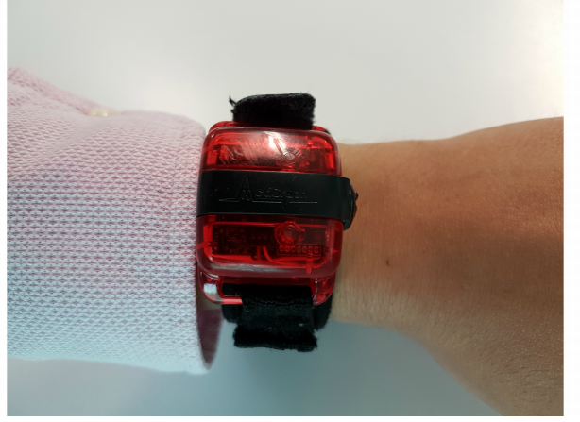
Methods of the Study
1
The collection of wearable data (sleep patterns & physical activities)
The dataset used contained complete actigraphy data from a subset of 92 adolescents over 1 week.
There were 322 total sleep instances:
102 from boys and
220 from girls.
Notes:
This is a common
problem with consumer-grade wearable devices, as users might
not wear them during the night (battery recharging, sensors
embedded in smart jewelry, and so forth)
Traditional prediction models applied to activity raw accelerometer data (eg, logistic regression) suffer from at least 2 key limitations: (1) They are not robust enough to learn useful patterns from noisy raw accelerometer output. As a result, existing methods for classification and analysis of physical activity rely on extracting higher-level features that can be fed into prediction models [34]. This process often requires domain expertise and can be time consuming. (2) Traditional methods do not exploit task labels for feature construction, and thus can be limited in their ability to learn task-specific features. Deep learning has the advantage that it is robust to raw noisy data, and can learn, automatically, higher level abstract features by passing raw input signals through nonlinear hidden layers while also optimizing on the target prediction tasks

Slide 9


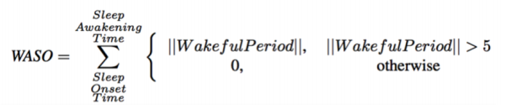
Methods of the Study
2
Data processing and representation
Those achieving a sleep efficiency score of ≥85% are thought to be good-quality sleepers,
and those with a score of <85% are thought to have poor-quality sleep
WASO is the sum of all moments of wakefulness lasting longer than 5 minutes
Notes:
To measure sleep quality we determined sleep efficiency
Total sleep time represents the amount of time that an individual spends asleep, less the amount of time the person awakens. This is calculated by subtracting the wake after sleep onset (WASO) from the duration of the sleep period.

Slide 10
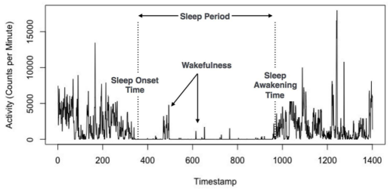
Methods of the Study
2
Data processing and representation
Notes:
This is a common
problem with consumer-grade wearable devices, as users might
not wear them during the night (battery recharging, sensors
embedded in smart jewelry, and so forth)
Traditional prediction models applied to activity raw accelerometer data (eg, logistic regression) suffer from at least 2 key limitations: (1) They are not robust enough to learn useful patterns from noisy raw accelerometer output. As a result, existing methods for classification and analysis of physical activity rely on extracting higher-level features that can be fed into prediction models [34]. This process often requires domain expertise and can be time consuming. (2) Traditional methods do not exploit task labels for feature construction, and thus can be limited in their ability to learn task-specific features. Deep learning has the advantage that it is robust to raw noisy data, and can learn, automatically, higher level abstract features by passing raw input signals through nonlinear hidden layers while also optimizing on the target prediction tasks

Slide 11
Methods of the Study
3
Data modelling
The input of the models is time series vectors, X=(x1 , · · · , xT ),
The output of the model was a binary classification decision between good and poor sleep quality based on sleep efficiency (%)
Logistic regression, a non-deep learning model
Multi-layer perceptron's (MLPs), a deep learning model
Convolutional neural network (CNN), a deep learning model
Recurrent neural networks (RNN), a deep learning model
Long short-term memory (LSTM) RNN, a deep learning model
Time-batched long short-term memory (TB-LSTM) RNN, a deep learning model
The data were split with a
70% training
15% testing
15% validation
Notes:
Input: representing the physical activity of a person’s awake time. Each vector corresponded to a continuous period of awake time, and so for each individual, there might be multiple such vectors over the 7 days. Each xT represented the value of the vertical axis at time t.
LR: The optimal setting for logistic regression (LR) was with a mini-batch size of 5 and a dropout ratio of 0.5.
MLPs, also known as feed-forward neural networks, are the simplest models in the deep learning family. They have one or more hidden layers. In fact, MLP without any hidden layers is equivalent to logistic regression. In MLP, all the units of a hidden layer are fully connected to the units in the previous layer. The best parameter configuration for MLP was with a mini-batch size of 20, a dropout ratio of 0.1, and a hidden layer size of 15.
CNN For its best configuration, we used 25 hidden nodes, filter length of 5 and pooling length of 4, 5 mini-batch size, and 0.0 dropout ratio
RNN performed best with a mini-batch size of 5, a dropout ratio of 0.1 and a hidden layer size of 75. To avoid over-fitting, we used a technique based on dropout of hidden units and early stopping based on the loss on the development set
LSTM A subtype of RNN, LSTM uses specifically designed memory blocks as units in the recurrent layer to capture longer-range dependencies. The optimal configuration values for LSTM were a mini batch size of 5, dropout ratio of 0.5, and hidden layer size of 100.
TB-LSTM To further improve our implementation of LSTM, we constructed batches of time steps by merging accelerometer measures over time steps. We referred to this version of the model as TB-LSTM. The configuration values for TB-LSTM were mini-batch size of 5, dropout ratio of 0.5, and hidden layer size of 100.

Slide 12
Methods of the Study
4
Performance evaluation
Accuracy
It is computed as the proportion of correct predictions, both positive and negative
F1-Score
An inverse relationship between precision and recall (harmonic mean of precision and recall)
Precision
It is the fraction of the number of true positive predictions to the number of all positive predictions
Area Under the ROC Curve
It represents the probability that a classifier will rank a randomly chosen positive instance higher than a randomly chosen negative instance
Specificity
It is the fraction of the number of true negative predictions to the actual number of negative instances in the dataset
Recall or Sensitivity
It is the fraction of the number of true positive predictions to the actual number of positive instances in the dataset
Notes:
area under the receiver operating characteristic (ROC) curve (AUC)
Accuracy: sum of true positives and true negatives divided by the number of all instances in the dataset
Precision: , true positives divided by the sum of true positives and false positives. In our case, precision described what percentage of the time the model predicted “good-quality sleep” correctly. Note that precision is also known as positive predictive value.
Specificity: , true negatives divided by the sum of true negatives and false positives. In our case, specificity referred to the percentage of the correctly predicted “poor-quality sleep” to the total number of “poor-quality sleep” instances in the dataset. Note that specificity is also known as true negative rate.
Recall: ie, true positives divided by the sum of true positives and false negatives). In our case, recall referred to the percentage of the correctly predicted “good-quality sleep” to the total number of “good-quality sleep” instances in the dataset. Note that recall is also known as true positive rate or sensitivity
F1: That is, it is possible to increase the precision at the cost of decreasing the recall, or vice versa. Therefore, it is more useful to combine them into a single measure such as F1 score, which computes the harmonic mean of precision and recall.
ROC/AUC: Hence, AUC defines an effective and combined measure of sensitivity and specificity (which are often inversely related, just like precision and recall) for assessing inherent validity of a classifier

Slide 13
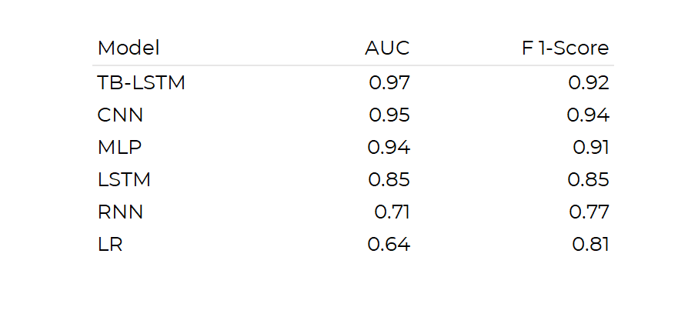
Results of the study
Notes:
Take in consideration that they reduced the problem to a binary one: good or bad, so 0.5 means good. (Considerations)
F1-score is a metric which takes into account both precision and recall - harmonic mean of precision and recall.
First of all we are gonna look at a simple table noting the Area Under the Curve and F1 scores of each model. The first thing we notice here is that there’s a gap between the top 3 models and the bottom 3. The Time batched LSTM, the Convulitoonal Neural network and the Multi layer perceptron were the models with the best scores overall, all really close to each other, and then we have the last bottom 3 where the other 2 Nerual Network models also got decent scores but the Logistic Regression model really underperformed here.

Slide 14
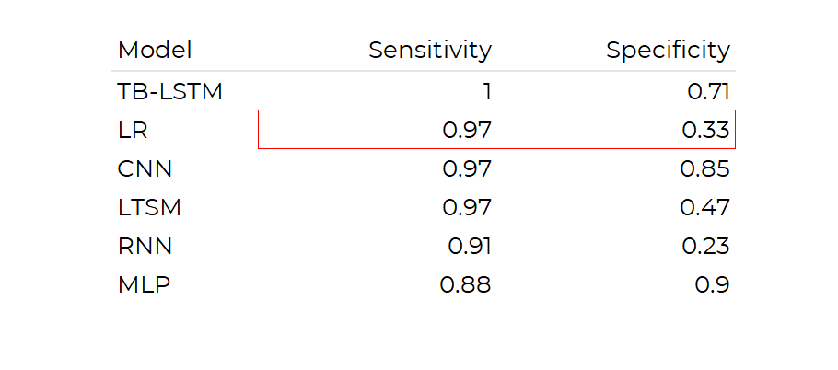
Results of the study
Notes:
Recall: True positive rate. Specificity: True negative rate -> since misidentifying poor sleep cases can lead to underdiagnosis of problematic sleep. Specificity determines a model’s ability to predict if an observation does not belong to a specific category
Well, in this other table we are noting the Sensitivity, the True Positive rate of each model and the Specificity, a mètric that determines a model’s ability to predict if an observation does not belong to a specific category. Why are this metrics important? Well, misidentifying poor sleep cases can lead to an underdiagnosis of problematic sleep and we are precisely trying to avoid that.
Take a look the the second best model in terms of sensitivity. That is the Logistic Regression one. Then look at his Specificity score: its horrible. Therefore, we conclude that the Logistic Regression model has a lot of trouble predicting negative samples of sleep quality.
If we look at both scores we have no doubt that the best model is the Time batched LSTM.

Slide 15
Conclusions of the study
We can predict sleep quality using only physical activity
Deep learning overperforms classical methods
Notes:
Deep learning performed better than classical methods. deep learning models compute abstract features from raw input signals
So, in conclusion, weve seen that DL models overperformed classical one, that is, the Logistic Regression one. A reasonable justification for that is that the DL models compute abstract features from raw input signals whilst classical ones just try to fit the input data to some kind of binary decision. Nevertheless, this paper shown that we can predict with high accuracy sleep quality only using physical activity during the day.

Slide 16
Discussion & Limitations
Models can be re-used using wearable's data
What about the age?
Binary simplification
Deep learning models understanding
Data cleaning
Notes:
So, moving a little bit forward, lets discuss some limitations and issues about this study. The first insight that I’m gonna highlight is that well we can re use this models using wearables data, like smartwatches or smartbands instead of this weird device that we shown in past slides. This opens up to more possibilities like expanding the age range, which brings me to point 2. In this study, the data comes from teneegers, so we don’t know how well will this models perform with data from various age ranges.
In third place, remember that they reduced the problem of classificating sleep quality to a binary one: good or bad, so, an interesting future work would be trying to maybe add some more variables to this decision making problem.
Following with DL models, we all know that the behaviour of NN models is hard to understand, we call this models “black boxes” so we always have to be careful of what patterns are using this type of models and how do we justify this predictions.
Finally, a big limitation of this kind of studies is the data cleaning that needs to be done to activity and physical data. If we want more accuracy, more complex solutions we are gonna need more complex data and this one is really hard to clean.
Well, this is it from Lasha and me so we hope youall liked it and thank you for listening.

Slide 17
Data Science for Health

